Slide 1
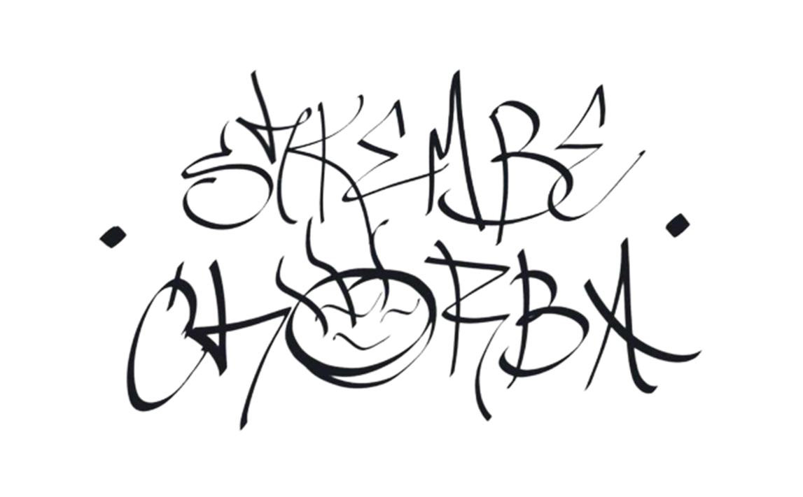

Slide 2




Our team
Scrum trainer
Perla Hristova
Front-end developer
Luchezar Rashkov
Front-end developer
Simeon Stefanov
Designer
Nedyalko Libchev

Slide 3

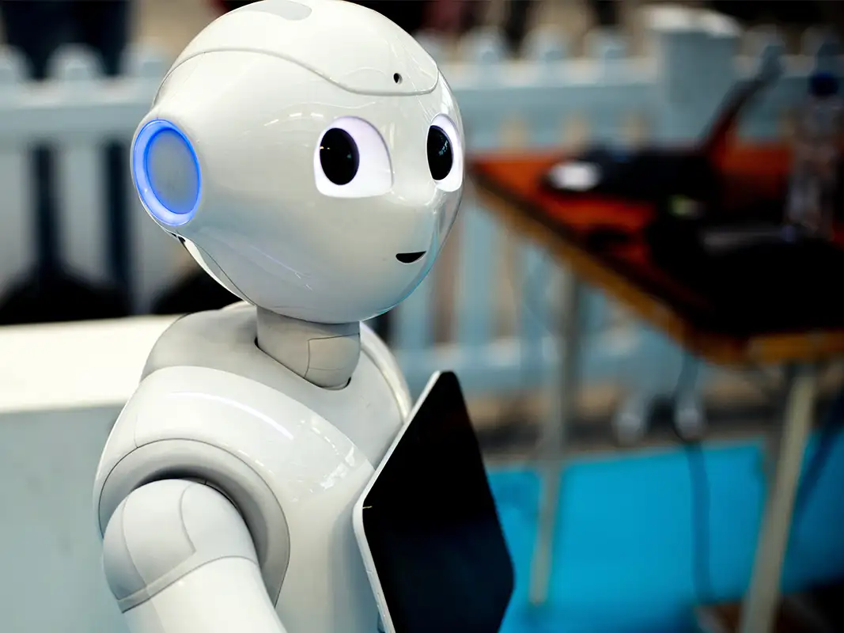
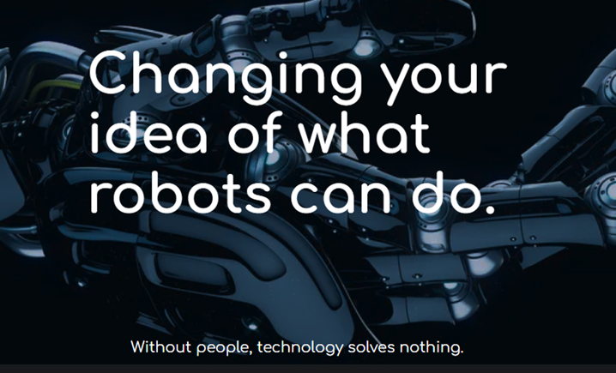
The idea
The idea originates from our desire to inspire people to learn more about robotics by providing them with the newest information. By acknowledging this new information, we aim to stimulate their motivation to learn more and make them aware of the constant changes in the field of technology.

Slide 4





Our main goal
We want to inspire young programmers who have just began their path in programming. We want to show them our progression in such a short time.​
We want to educate the people about robots and the world of robotics. Our team wants to teach them important things about the world of robotics.​
Our team wants to give them information about robots and how interesting they are.​
​

Slide 5









Technologies used

